Slide 1






Intrusion Prevention System (IPS)
Supervised by :
Dr Mohamed Taha eng Ahmed Tawfiq

Slide 2
PRESENTED BY
1 - Salah Foad Mohamed 2 - Mai Medhat Qandil 3 - Shahd Hassan Farag 4 - Mohamoud Sarwat El kholy 5 - Ahmed Megahed Shaker

Slide 3
Introduction Problem Statement What is an IPS? Objectives IPS VS. Firewall IPS architecture
Agenda
IPS's Detection methods
System tools
OPNsense firewall
What is Suricata?
Challenges Faced
1
7
2
8
3
9
4
10
5
11
6

Slide 4

01
introduction

Slide 5
Introduction
The importance of cybersecurity today
Real world example of intrusions
Devastating consequences of data breaches

Slide 6

02
Problem Statement

Slide 7
Problem Statement
The increasing threat landscape.
Limitations of traditional firewalls and basic IDS.
The need for proactive intrusion prevention.

Slide 8

03
What is an IPS?

Slide 9
IPS definition
It is a proactive security solution that actively monitors network traffic
detect and prevent cyber threats in real time.
It takes immediate action by blocking malicious traffic, dropping packets, or resetting connections.

Slide 10

04
Objectives

Slide 11



objectives
Real time Logging and Monitoring Network Traffic
Seamless Integration
Real Time Threat Detection and Prevention.
Faster Incident Response

Slide 12

05
IPS vs. Firewall

Slide 13
IPS architecture
06

Slide 14
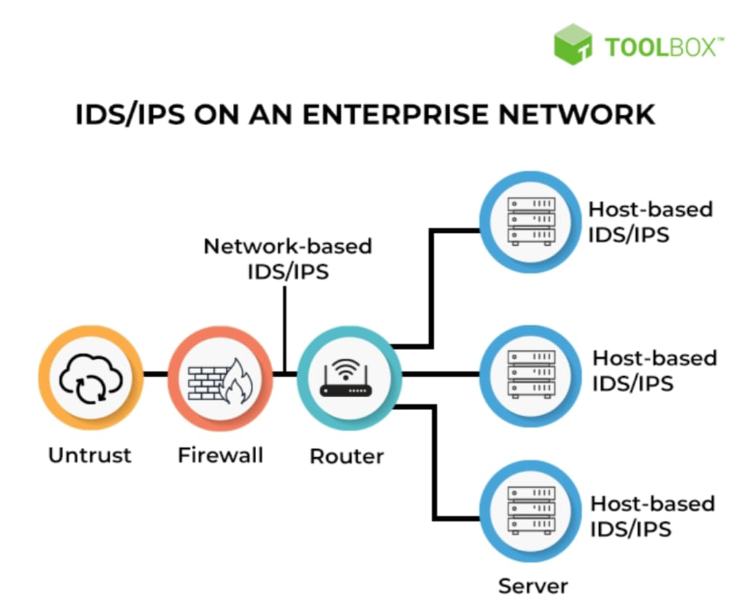
IPS architecture
Network-based IPS (NIPS):
Deployed at network boundaries to monitor all traffic.
Host-based IPS (HIPS):
Installed on individual machines to Protects internal activities .

Slide 15
Detection techniques
07

Slide 16
Detection techniques
Anomaly-Based Detection
Can detect new/unknown threats and detect zero-day attacks.
Hybrid Detection
Matches known threat patterns or rules (like antivirus software)
Combines both to improve accuracy and coverage.
Signature-Based Detection

Slide 17
08
System tools

Slide 18
System tools
Intrusion Prevention System (Suricata)
integrated Firewall Protection (OPNsense)
Virtualization with Vmware
( Metasploit for DoS Attacks )
Programming language : python
Operating system : linux

Slide 19





System tools

Slide 20

OPNsense firewall
9

Slide 21
OPNsense firewall
It is a free and open-source operating system
install on a physical machine or virtual server
It handles :
Firewall (stateful packet inspection)
NAT (network address translation)
Routing
VPN connections
Web GUI management

Slide 22

What is Suricata?
10

Slide 23
Suricata
It is an open-source IDS/IPS/NSM engine developed by the Open Information Security Foundation (OISF).
It utilizes rules and signatures to identify and block known attack patterns and suspicious behavior.
Uses deep packet inspection (DPI) and behavior-based analysis

Slide 24
Suricata
The most important Suricata features and capabilities are :
• Deep packet inspection
• Packet capture logging
• Intrusion Detection
• Intrusion Prevention
• IDPS Hybrid Mode
• Network Security Monitoring
• Anomaly Detection
• Multitenancy
• File Extraction (from protocols like SMTP, HTTP, etc.)
• Advanced protocol inspection
• Multi-threading

Slide 25
Challenges Faced
11

Slide 26
Challenges Faced
False positives : Some legitimate traffic was misidentified as malicious.
High CPU usage : During heavy packet inspection.
Rule management : Overloaded rules slow down performance.
Inline mode latency : Slight delay in packet forwarding.
Learning curve : Complex configuration and understanding Suricata syntax.

